Slide 1

Chicago Crash Data Let’s get wrecked!
Andrew Baker
Romi Sinnigen
Jonathan Hicks
Andrew Bankston

Slide 2

Hypotheses and Data Collection
Data source: https://catalog.data.gov/dataset/traffic-crashes-crashes
Time Frame: 2015-2021
Goal: To analyze the Chicago crash data for any trends that might help in the development of strategies to mitigate future crashes and injury.
City of Chicago Vision Zero plan to work with the community to prioritize human life and safety of Chicago's streets.
Hypotheses
There will be more crashes at night when it is dark
There will be more crashes during the holidays
There will be more fatal injuries with higher costs of damage
There will be more fatalities in slower speed limit zones
There is a relationship between crash count and traffic way type
Roadway types will not have a strong effect on the types of crashes that occur
There will be more crashes around high schools
There will be more crashes facing west towards the sunset

Slide 3
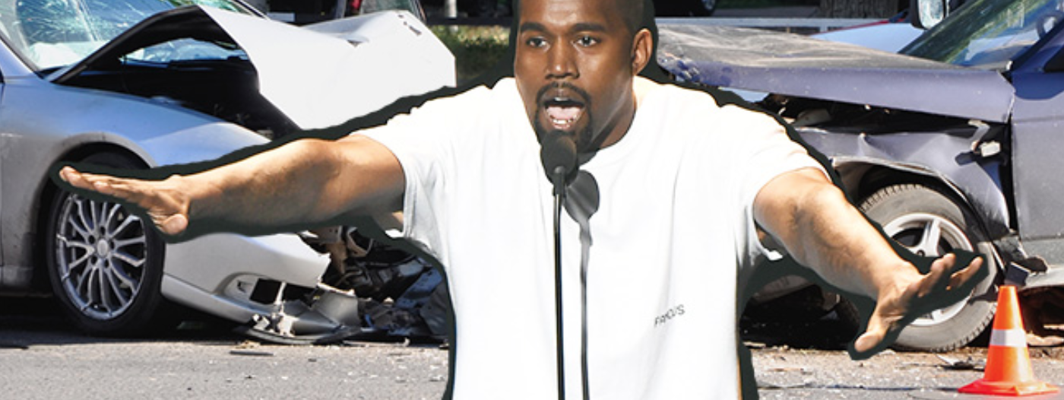
data breakdown

Slide 4
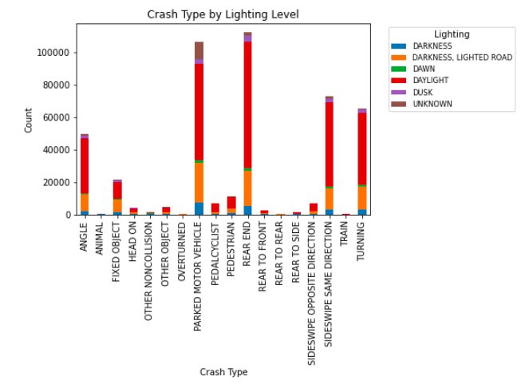
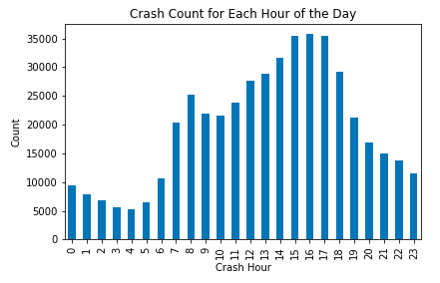
There will be more crashes at night when it is dark
Crash count is significantly higher during daylight hours (red bar)
From the hours of 7am to 7pm we can see the highest counts of crashes.

Slide 5
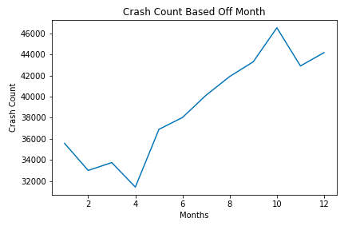
There will be more crashes during the holidays
There is a clear spike in crash count when we reach October through January.
We cannot assume causation, but the correlation would have us believe that more crashes occur around the holidays.

Slide 6
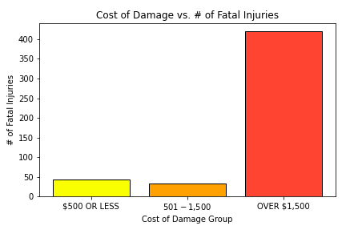
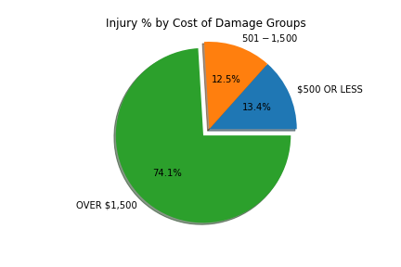
There will be more fatal injuries with higher costs of damage
74.1% of injuries fall within the damage group of over $1,500.

Slide 7
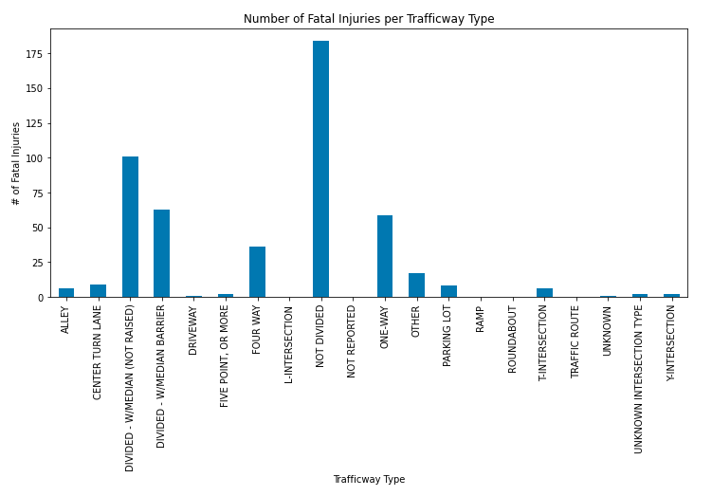
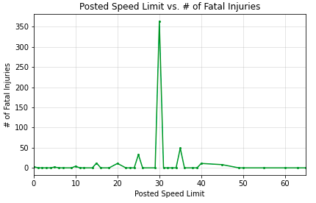
There will be more fatalities in slower speed limit zones
Majority of fatal injuries are in areas where the posted speed limit was 30mph.

Slide 8
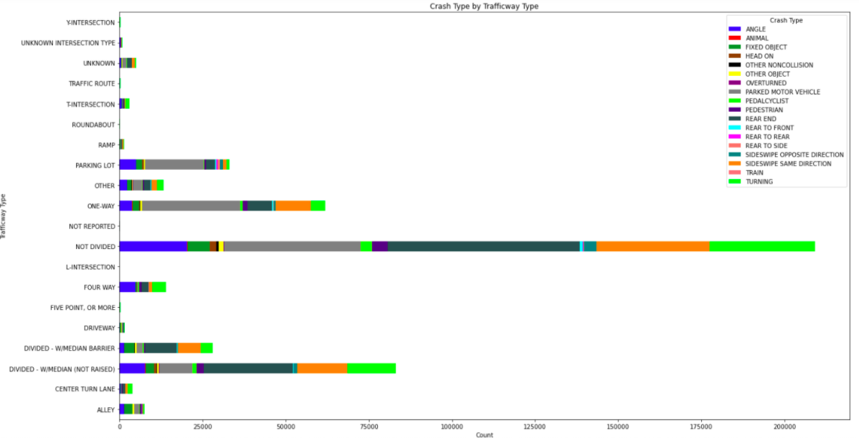
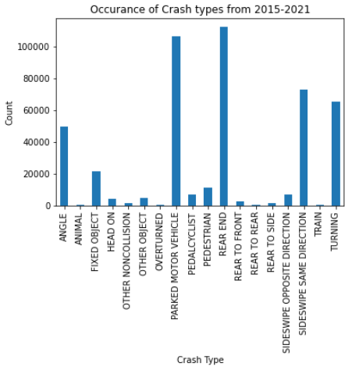
Roadway types will not have a strong effect on the types of crashes that occur

Slide 9
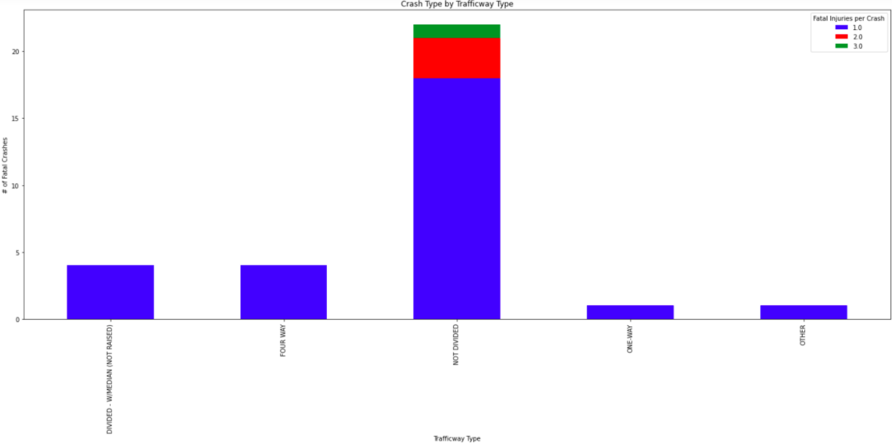
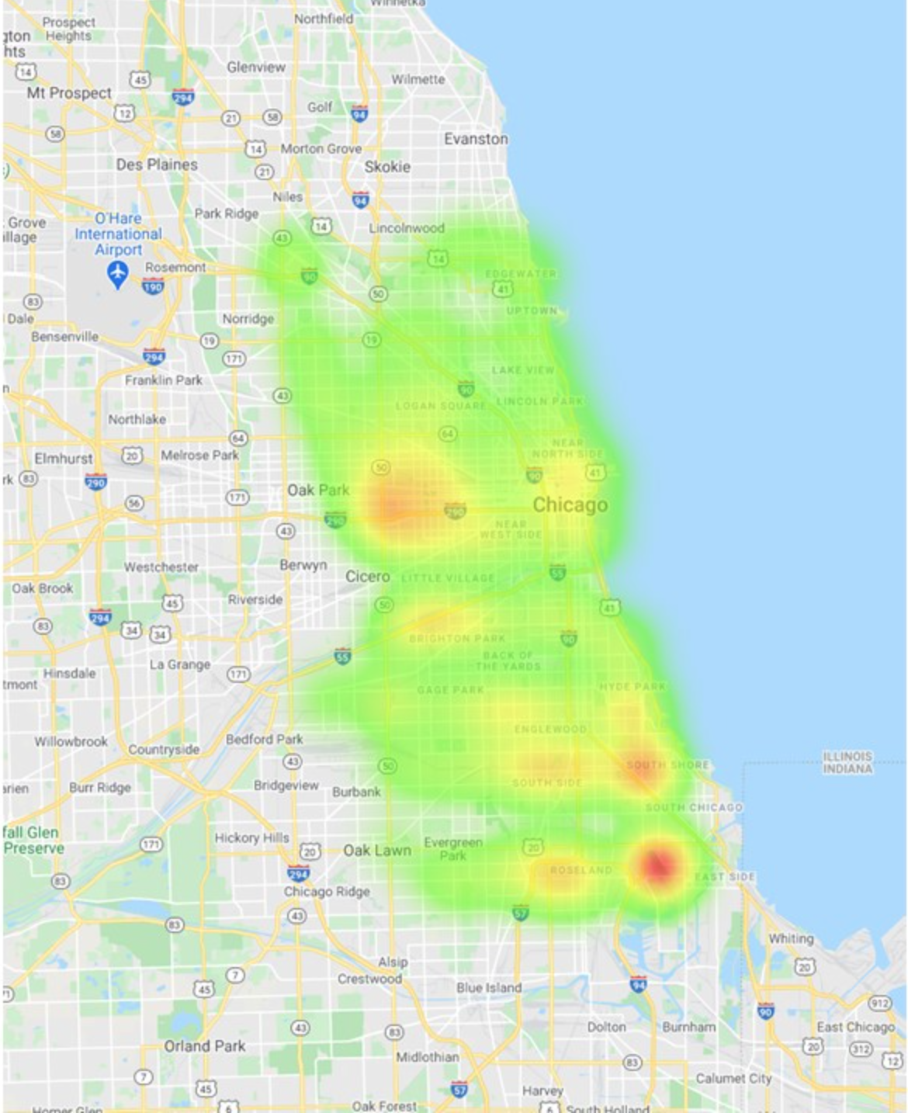
There is a relationship between crash count and traffic way type
Majority of crashes happen in a non divided traffic way.
A two lane road with a painted double yellow dividing them

Slide 10
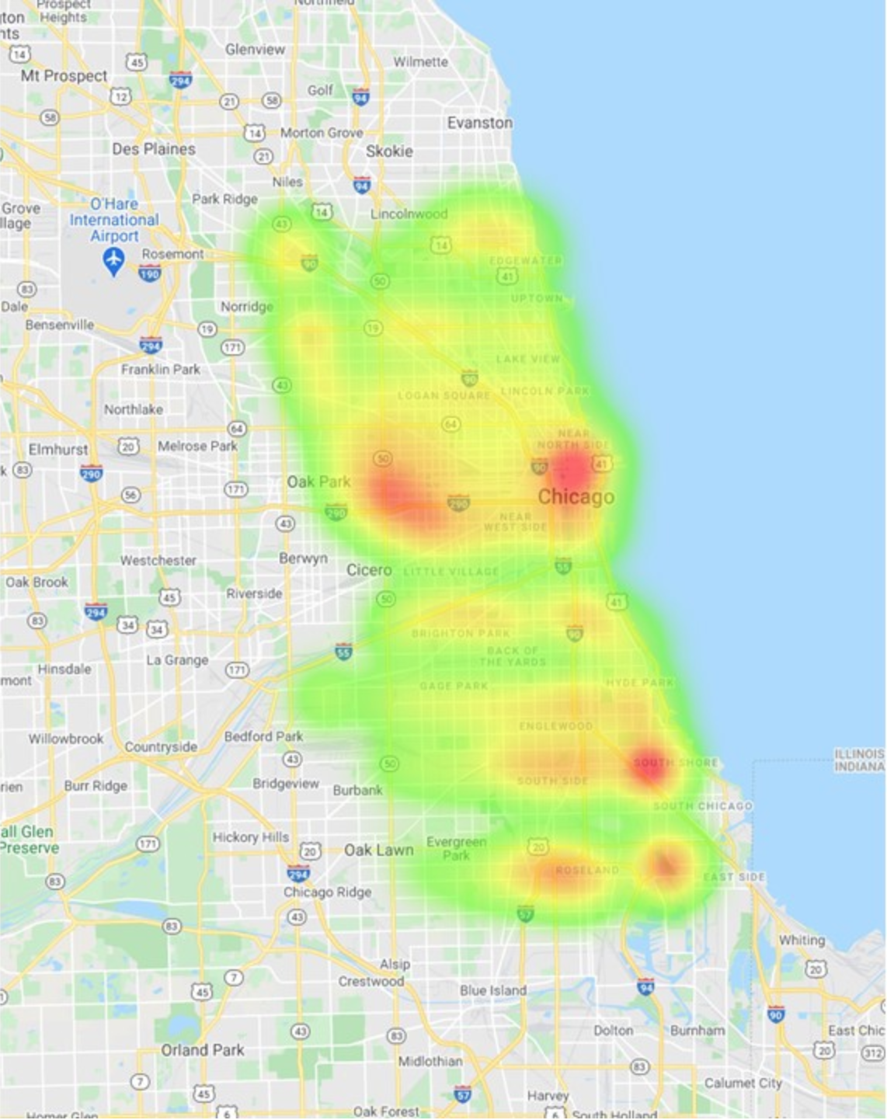
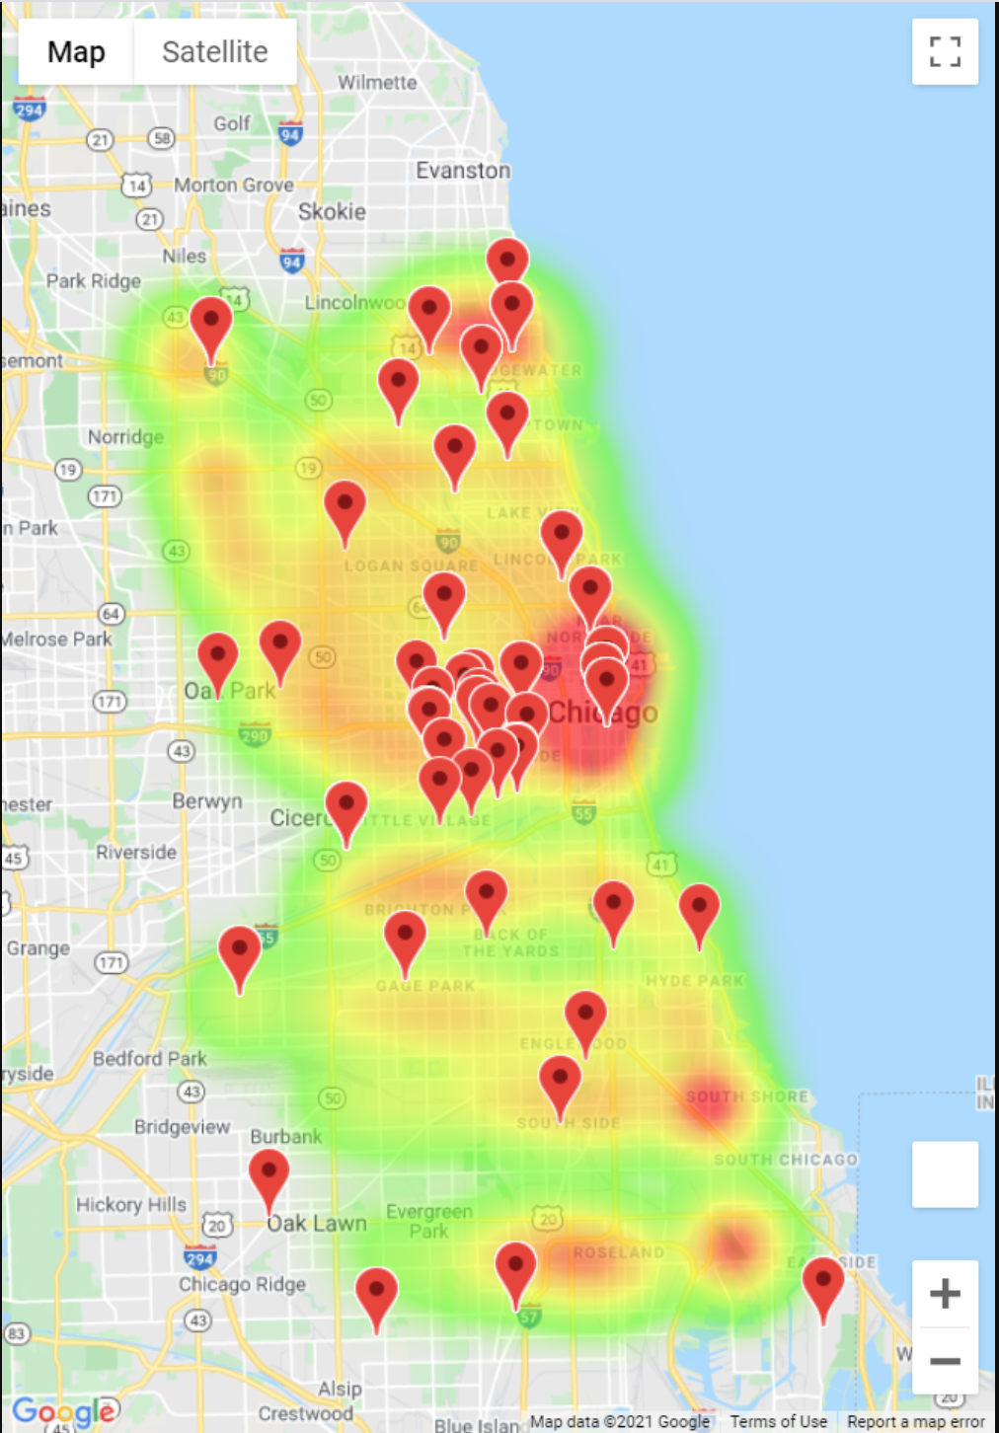
There will be more crashes around high schools
Injury Count
Crash count with High Schools
Although plenty of crashes occur near high schools, there are plenty of locations that experience a high frequency of accidents without a local high school nearby.
As well, there are some high schools that have minimal accidents nearby.

Slide 11
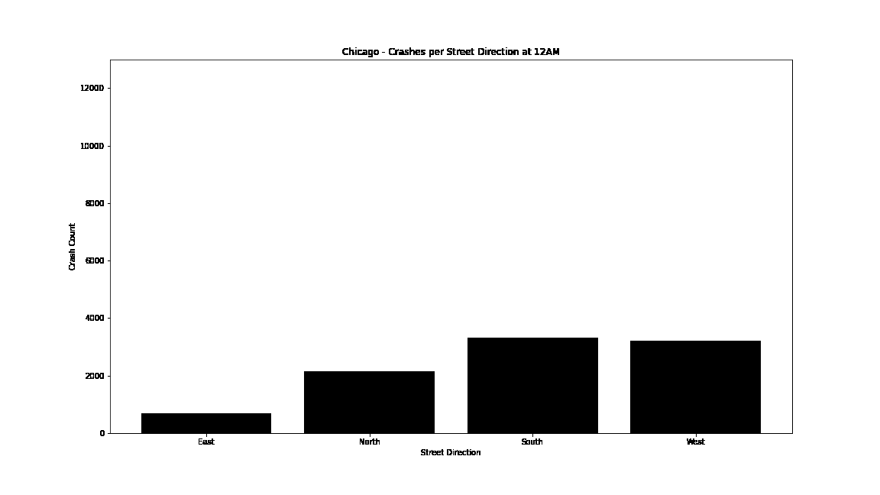
There will be more crashes facing west towards the sunset
Over 4x more accidents happen on Westbound roads than Eastbound.
This disparity holds true throughout a 24 hour period.

Slide 12
Final Thoughts

Slide 13

Post mortem
How difficult it was to find data sets that provided enough information to work with
Surprised how many hypotheses turned out to be wrong
Less crashes at night which was opposite of what we initially assumed the data would represent
Could be because there are more cars during the day
We thought time of day would affect crash count (North, East, South, West)
Maybe there are more crashes in the evening when driving towards the sunset
People are leaving the cost (east) and driving home (west)
Not nearly as many head-on collisions as initially assumed
Perhaps collisions occur more because of carelessness than recklessness

